Slide 1


Development of a Low-cost Sensor Chain for Photosynthetically Active Radiation Measurement
Sarah Tallack
Supervisor: Robyn Verrinder

Slide 2
Development of a Low-cost Sensor Chain for Photosynthetically Active Radiation Measurement
Sarah Tallack
Supervisor: Robyn Verrinder

Slide 3
Background & Motivation
The Southern Ocean’s Marginal Ice Zone (MIZ) plays a crucial role in global climate patterns.
Recent studies suggest that Phytoplankton growth may precede sea-ice retreat.
Notes:
Previously, a common assumption was that phytoplankton blooms occurred as a direct result of sea-ice retreat.
Recent studies suggest that phytoplankton growth is occurring before the sea-ice retreat.

Slide 4
Background and Motivation

Slide 5
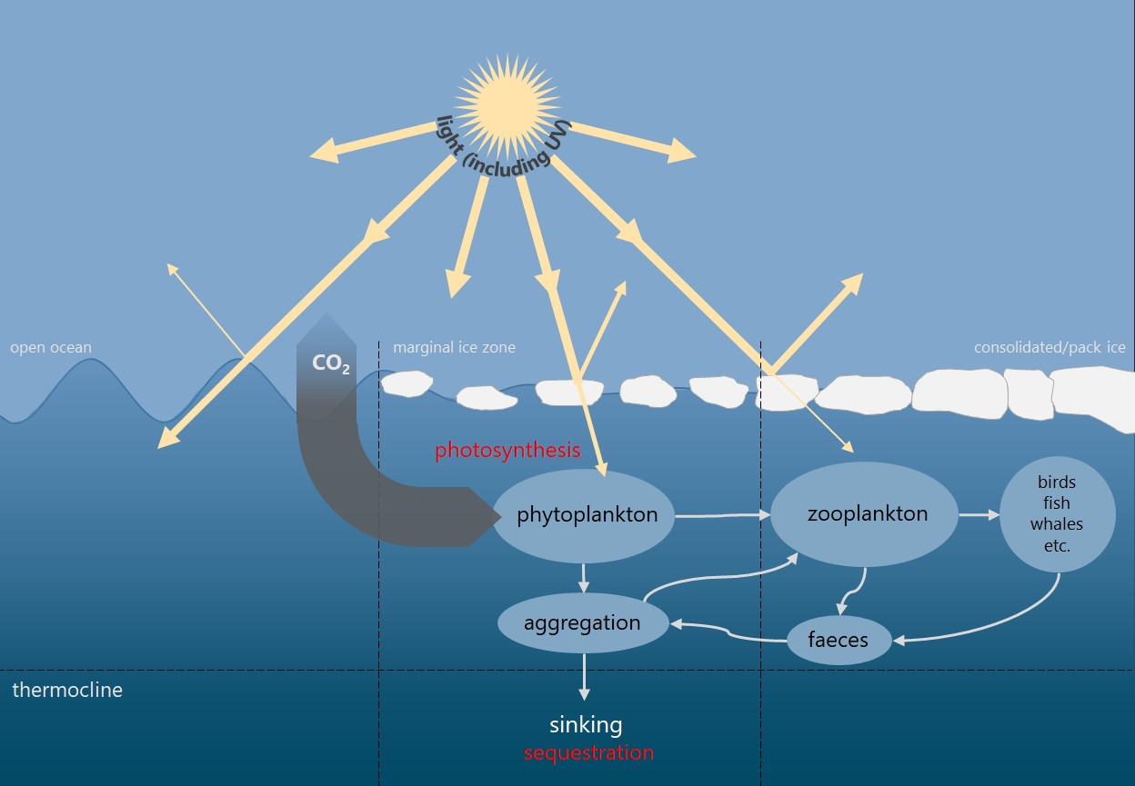
Photosynthetically Active Radiation (PAR) and Phytoplankton
PAR is the range of light wavelengths (400nm – 700nm) that are used in the process of photosynthesis. Unit of measurement: μmole.m²/s
Phytoplankton are single celled organisms that form the base of the Southern Ocean food web.
Diagram showing connections between phytoplankton and larger food web, adapted from [Deppeler, 2017]

Slide 6
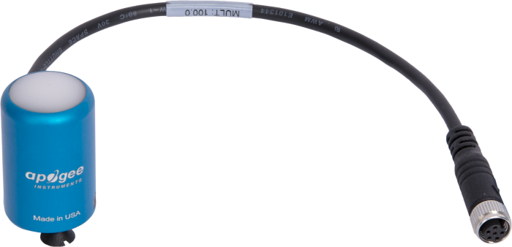
Existing PAR Sensors and Limitations
Commercially available PAR sensors are expensive.
High-cost limits deployments in areas with high sensor loss risk.
Example of a commercially available PAR sensor from Apogee Instruments
Notes:
Possibly discuss general structure
- Photodiode with carefully selected optical filter,

Slide 7
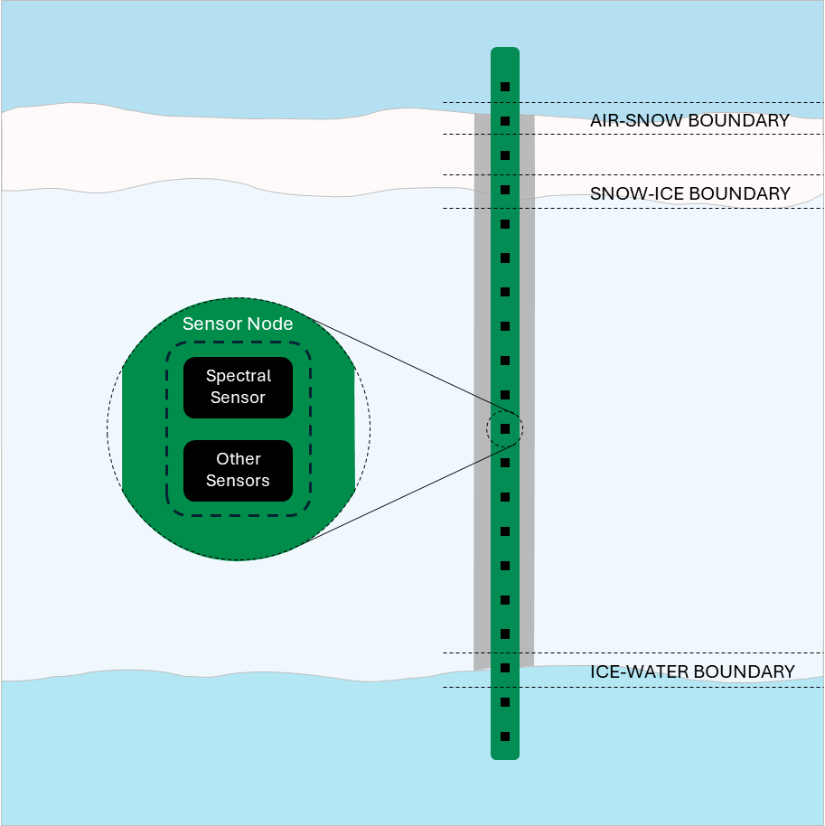
Proposed Solution: Low-cost Sensor Chain
Develop a robust and affordable PAR sensor chain using readily available components.

Slide 8
Methodology
Sensor selection and calibration
Sensor node design
Obtain calibration data
Develop calibration method
Sensor chain design and development
Expand sensor node design into a sensor chain design
Sensor chain housing design

Slide 9
Expected benefits and impact
Increased in-situ data collection within MIZ
Improved understanding of Antarctica sea-ice radiative transfer
Deeper insights into under-ice phytoplankton growth patterns.

Slide 10
Thank you

Slide 11
References
L. A. Clementson and B. Wojtasiewicz, “Dataset on the in vivo absorption characteristics and
pigment composition of various phytoplankton species,” Data in Brief, vol. 25, p. 104 020, 2019,
ISSN: 2352-3409.
S. L. Deppeler and A. T. Davidson, “Southern ocean phytoplankton in a changing climate,” Frontiers
in Marine Science, vol. 4, 2017, ISSN: 2296-7745. DOI: 10.3389/fmars.2017.00040.
[Online]. Available: https://www.frontiersin.org/articles/10.3389/fmars.
2017.00040.

